Slide 1
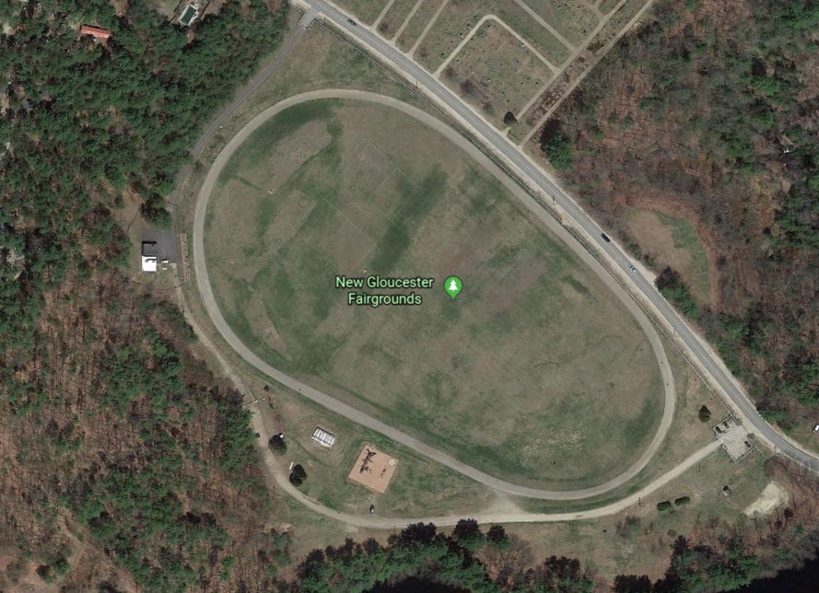
Green = Pavilion
Yellow = Parking Areas

